Slide 1


Slide 2
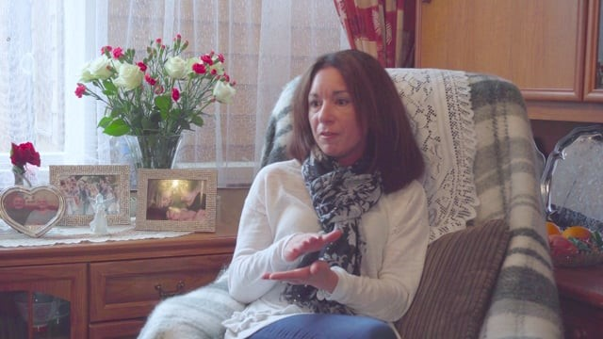

Slide 3
So, on behalf of

Slide 4
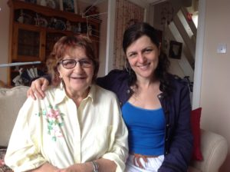
Pamela & Jo

Slide 5
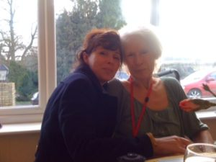
Amanda and Catherine

Slide 6
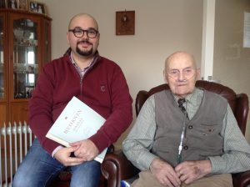
Alessandro and George

Slide 7
Queenie, Kitty, Jim,Charlotte, Ann, and all of us at The Voluntary Network, Thank you so much for your support x

